Slide 1
Quick Sort

Slide 2
Contents
Introduction to Quick Sort
Quick Sort Algorithm
Quick Sort Procedure
Complexity
Advantages and Disadvantages

Slide 3
What is Quick short?
Quicksort is the widely used sorting algorithm that makes n log n comparisons in the average case for sorting an array of n elements.
It is a faster and highly efficient sorting algorithm.
This algorithm follows the divide-and-conquer approach.
Divide and conquer is a technique of breaking down the algorithms into subproblems, then solving the subproblems, and combining the results back together to solve the original problem.

Slide 4
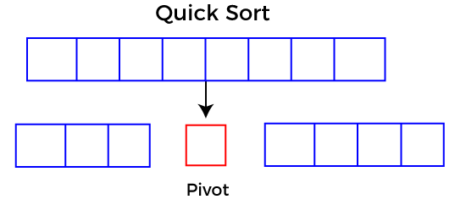
How does Quick Sort Work?
Quicksort picks an element as a pivot, and then it partitions the given array around the picked pivot element.
In quick sort, a large array is divided into two arrays in which one holds values that are smaller than the specified value (Pivot), and another array holds values that are greater than the pivot.

Slide 5
How to Select a Pivot?
Picking a good pivot is necessary for the fast implementation of quicksort. However, it is typical to determine a good pivot. Some of the ways of choosing a pivot are as follows -
    Pivot can be random, i.e. select the random pivot from the given array.
    Pivot can either be the rightmost element or the leftmost element of the given array.
    Select median as the pivot element.

Slide 6

Quick Sort: Example
To understand the working of quick sort, let's take an unsorted array. It will make the concept more clear and understandable. Let the elements of the array are,
In the given array, we consider the leftmost element as pivot. So, in this case, a[left] = 24, a[right] = 27 and a[pivot] = 24.

Slide 7
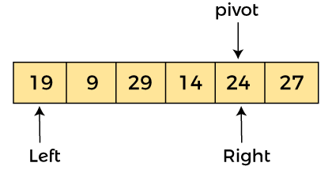
Quick Sort: Example
Since the pivot is at left, so algorithm starts from right and moves towards left.

Slide 8
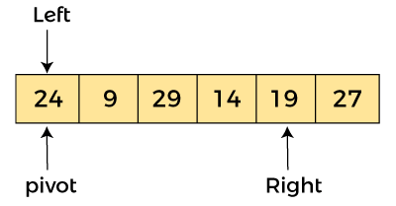
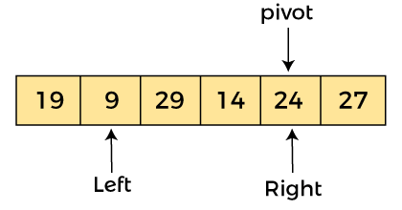
Quick Sort: Example
Step 1: Scan the array from right to left and replace the first element which is less than the pivot, with the pivot value.
Here 19 is the first element which is less than pivot 24, for this reason, 19 is replaced by 24.

Slide 9
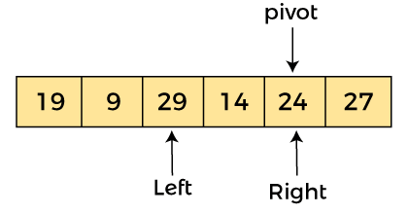
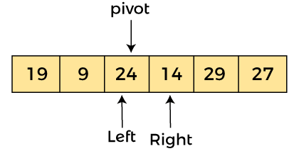
Quick Sort: Example
Step 2: Scan the array from left to right and replace the first element which is greater than the pivot, with the pivot value.
Here 29 is the first element which is greater than pivot 24, for this reason, 29 is replaced by 24.

Slide 10
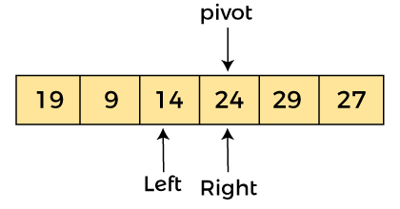
Quick Sort: Example
Step 3: Scan the array from right to left and replace the first element which is less than the pivot, with the pivot value.
Here 14 is the first element which is less than pivot 24, for this reason, 14 is replaced by 24.

Slide 11

Quick Sort: Example
Finally, the array is now divided into two parts one part is less than the pivot and the other part is greater than the pivot.

Slide 12
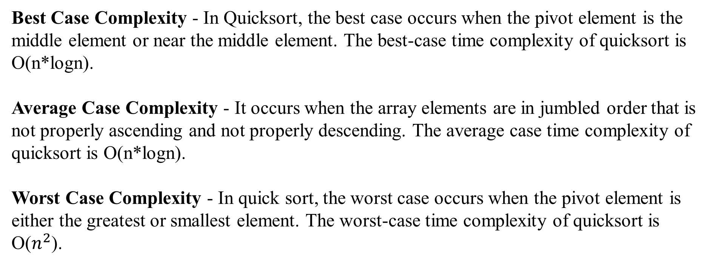
Time Complexity
Best Case Complexity - In Quicksort, the best case occurs when the pivot element is the middle element or near the middle element. The best-case time complexity of quicksort is O(n*logn).
Average Case Complexity - It occurs when the array elements are in jumbled order that is not properly ascending and not properly descending. The average case time complexity of quicksort is O(n*logn).
Worst Case Complexity - In quick sort, the worst case occurs when the pivot element is either the greatest or smallest element. The worst-case time complexity of quicksort is O($n^{2}$).

Slide 13
Any Question?

Slide 14


